Slide 2
CONTENTS: 1.LOCATION /LAND 2. CLIMATE 3.VEGETATION PLANT LIFE ANIMAL LIFE 4.ECONOMIC RESOURCES 5.LIFE OF THE PEOPLE 6.TRANSPORT 7.CITIES
6.THE LAND OF DENSE FORESTS

Slide 3
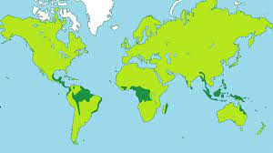
EQUATORIAL FORESTS

Slide 4
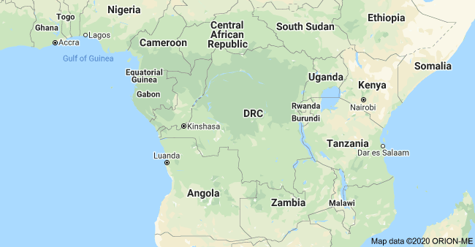
LOCATION/LAND
THE REGION BETWEEN TROPIC OF CANCER AND THE TROPIC OF CAPRICORN IS EQUATORIAL REGION

Slide 5
LOCATION OF DRC
THE DRC IS THE SECOND LARGEST IN AFRICA.
THE EQUATOR PASSES THROUGH THE NORTHERN PART OF THE COUNTRY.
THE COUNTRY IS LOCATED IN CENTRAL AFRICA.
IT IS SURROUNDED BY NINE COUNTRIES.
CHAPTER 6/KARUNAMBIGAI/SOCIAL DEPT/SNS ACADEMY

Slide 6
RIVER CONGO IS THE SECOND LONGEST RIVER IN AFRICA. IT IS KNOWN AS THE HIGHWAY OF CENTRAL AFRICA. IT IS SURROUNDED BY MOUNTAINS AND PLATEAUS. RUWENZORI MOUNTAIN IN THE NORTH-EAST. MOUNT MARGHERITA- HIGHEST PEAK. MAJOR LAKES ARE- ALBERT,EDWARD.KIVU AND TANGANYIKA.
Land
Chapter 6/social/karunambigai/Sns Academy

Slide 7
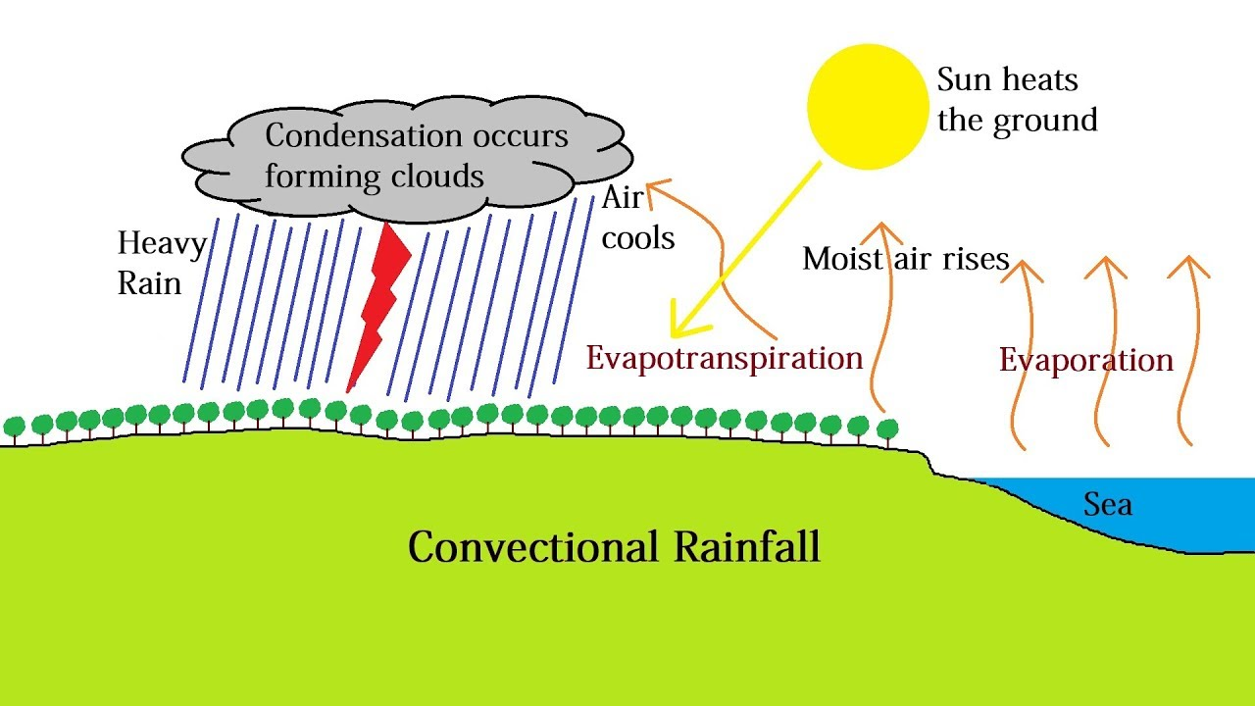
EQUATORIAL CLIMATE. VERY HOT AND RAINY THROUGHOUT THE YEAR. CONVECTIONAL RAINFALL
CLIMATE
The convectional rainfall is prevalent in equatorial regions. In these, the warm air rises up and expands then, reaches at a cooler layer and saturates, then condenses mainly in the form of cumulus or cumulonimbus clouds. In the equatorial regions, the precipitation due to convectional rainfall occurs in the afternoon
Chapter 6/social/karunambigai/Sns Academy

Slide 8
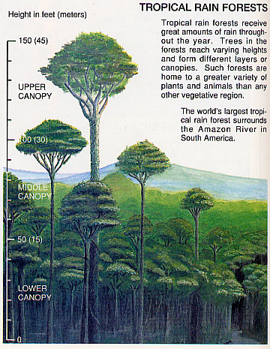
PLANT LIFE CANOPY A MASS OF LEAVES AND BRANCHES THAT SPREAD OVER AN AREA TO FORM A ROOF. EVERGREEN FOREST THE FOREST REMAIN GREEN THROUGHOUT THE YEAR. THE FOREST IS SO DENSE,IT IS DIFFICULT TO PASS THROUGH THEM.
VEGETATION

Slide 9
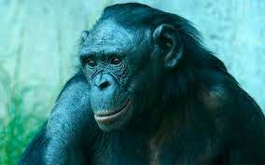
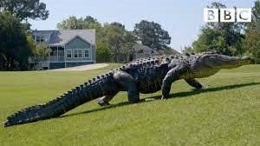
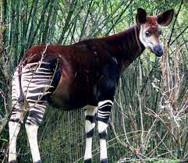
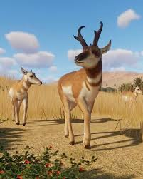
RICH IN WILDLIFE. GORILLAS,CHIMPANZEES,MONKEYS,BONOBOS AND BABOONS. HIPPOPOTAMUS.RHINOCEROS AND ELEPHANT. CROCODILES,ALLIGATORS AND FISH . OKAPIS AND ANTELOPES ARE FOUND IN ITURI FOREST. PELICANS,DUCKS.OWLS AND EAGLES.
WILDLIFE

Slide 10
FARMING ,FORESTRY,FISHING AND LIVESTOCK REARING –MAIN OCCUPATIONS. FOOD CROPS – RICE,MAIZE AND CASSAVA. CASH CROPS – COCOA,COFFEE,TOBACCO,COTTON,RUBBER AND OIL PALM. MINERALS – GOLD,COBALT,COPPER,CADMIUM,PETROLEM,DIAMOND,SILVER,ZINC,MANGANESE,TIN,URANIUM,IRON ORE,BAUXITE AND COAL.
ECONOMIC RESOURCES

Slide 11
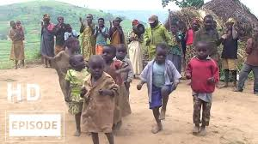
THE COUNTRY IS THINLY POPULATED. CASSAVA –ROOT STAPLE FOOD BANTU –TRIBAL PEOPLE,THEY FOLLOW TRADITIONAL LIFESTYLES. PYGMIES –INHABITANTS,THEY ARE ALSO KNOWNS AS BAMBUTI. THEY ARE VERY SHORT LESS THAN 150 CM TALL. THEY LIVE IN ITURI FOREST. THEY LEAD A PRIMITIVE LIFE.
LIFE OF THE PEOPLE

Slide 12
POOR LAND TRANSPORT. DENSE OF THE FOREST MADE DIFFICULT FOR BUILDING RAILWAYS AND ROADWAYS. THE COUNTRY HAS A NETWORK OF RIVERS. WATER TRANSPORT HAS BECOME THE CHIEF MEANS OF TRAVEL. AIR TRANSPORT IS VERY EFFECTIVE WAY TO TRAVEL. THE COUNTRY HAS MORE THAN 200 AIRPORTS.
TRANSPORT

Slide 13
30 % OF THE TOTAL POPULATION LIVES IN TOWNS AND CITIES. KINSHASA IS THE CAPITAL AND LARGEST CITY. LUBUMBASHI IS THE MAIN CITY & MINERAL – RICH REGION. BIG CITIES – KANANGA,KISANGANI, LIKASI,KIKWIT. MATADI –PORT CITY.
CITIES

Slide 14
.

